Slide 1
Linked Data Preview
Jay Myers,

Slide 2
Every day we create 2.5 quintillion bytes of data (equivalent to 3.4 billion HD movies)

Slide 3
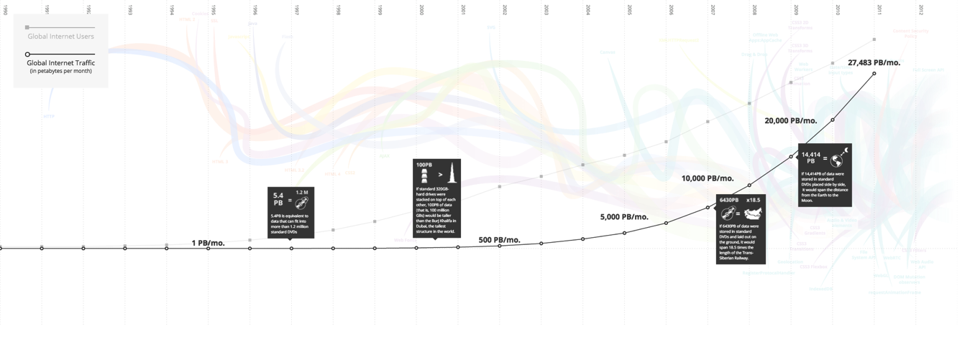
http://www.evolutionoftheweb.com

Slide 4
What if we could use these webs of data as a global DB?

Slide 5
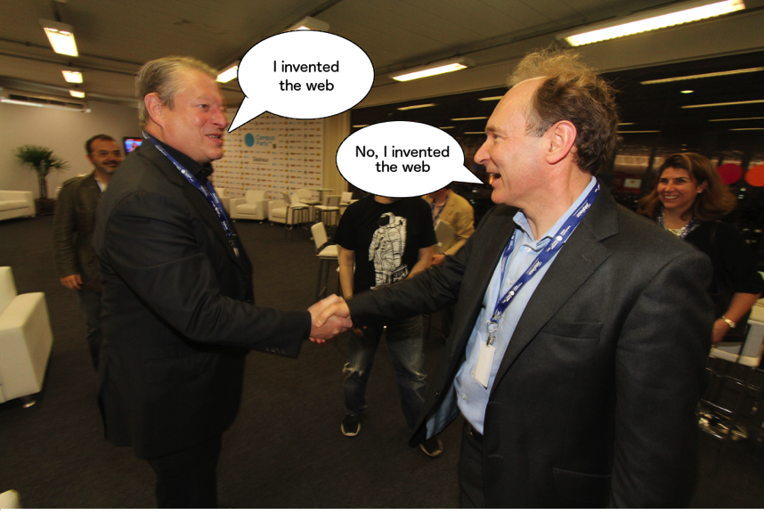
Linked Data
“A new form of Web content that is meaningful to computers
will unleash a revolution of new possibilities” - TBL

Slide 6
Linked Data is: A set of standards for publishing and connecting structured data on the web.

Slide 7
Linked Data
Built on common web principles: HTTP, URIs, hyperlinks
URIs to identify data entities and relationships between things
Easily combine data sources

Slide 8
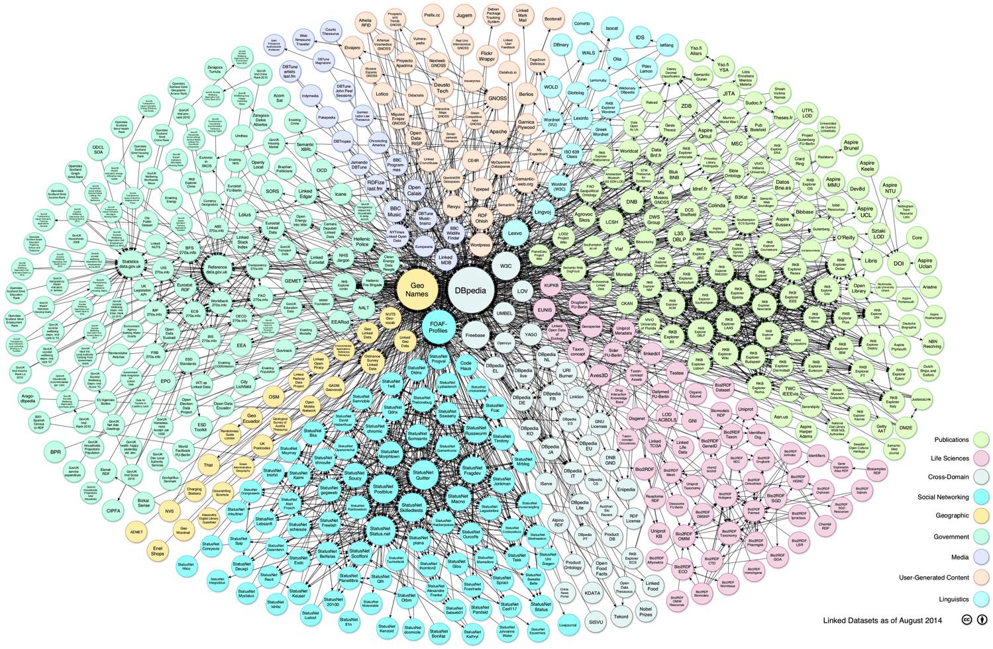
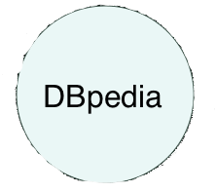
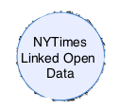
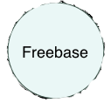
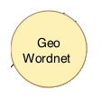

Slide 9
Built on RDF
“Resource Description Framework”
Model for data exchange on the web
Expresses relationships between things
Notes:
Comes in different flavors

Slide 10
The RDF “Triple”
Entity - Attribute - Value
or
Subject - Predicate - Object

Slide 11
Linked Data Vocabularies
Schemas for the web of data
Distributed over the web (via URIs!)
Resolvable on the web for people to discover and learn how to use

Slide 12
Popular Open Vocabularies
Name | URI | Description
Bio | http://purl.org/vocab/bio/0.1/ | Describes biographical information about people, both living and dead
FOAF | http://xmlns.com/foaf/0.1/ | “Friend of a Friend”, describes social networks and person relationships
FIBO | In development | “Financial Industry Business Ontology”, common vocabulary for financial terminology
Good Relations | http://purl.org/goodrelations/v1 | Annotates product offers and products
vCard | http://www.w3.org/2006/vcard/ns# | Describes People and Organizations

Slide 13
Make Your Own
@prefix gsp: <http://gs1.org/ns/product#> .
<http://gs1.org/ns/product>
a owl:Ontology ;
rdfs:label "GS1 Global Structured Commerce Classification Ontology"@en ;
rdfs:comment "GS1 Product Ontologies based off structured Commerce Classification work" ;
dct:creator [foaf:name "Jay Myers"] .
gsp:Product a rdfs:Class, owl:Class ;
rdfs:isDefinedBy <http://gs1.org/vocab/product> ;
rdfs:label "Product"@en ;
rdfs:comment "A GS1 recoginzed product" .
gsp:Book a rdfs:Class, owl:Class ;
rdfs:isDefinedBy <http://gs1.org/vocab/product> ;
rdfs:subClassOf gsp:BooksMusicMovies ;
rdfs:label "Book"@en ;
rdfs:comment "A product that is classified as a book" .
https://github.com/jaymyers/gs1-ontology

Slide 14
A Simple Triple
<http://jaymyers.com/jay/> foaf:name “Jay Myers”;

Slide 15
A Collection of Triples
<jay> a foaf:Person;
foaf:givenname "Jay";
foaf:family_name "Myers";
foaf:gender "Male";
foaf:phone <tel:6122965836>;
foaf:title "Technical Product Manager";
foaf:workplaceHomepage <http://www.bestbuy.com>;
foaf:knows <http://davidwormald.com/david/>.

Slide 16
Multiple RDF statements (and links!) connect to form graphs of data

Slide 17
“Jay”
“David”
<tel:6122965836>
<tel:6125551212>
foaf:givenname
foaf:givenname
foaf:phone
foaf:phone
foaf:knows
http://jaymyers.com/jay/
http://davidwormald.com/david/
foaf:knows
foaf:knows
foaf:knows
foaf:knows
foaf:knows
http://arunbatchu.net/arun/
foaf:phone
foaf:givenname
<tel:6125555555>
“Arun”

Slide 18
Let’s query the web of data!SPARQL: SPARQL Protocol and RDF Query Language

Slide 19
SELECT Query
Namespace prefix
prefix foaf: <http://xmlns.com/foaf/0.1/>
select ?firstname ?lastname ?phonenumber
from <http://jaymyers.com/jay/>
from <http://davidwormald.com/david/>
from <http://arunbatchu.net/arun/>
where{
?person foaf:givenname ?firstname ;
foaf:lastname ?lastname ;
foaf:phone ?phonenumber .
}
LIMIT 2
Three fields
Three data sources
Specify conditions
Return two

Slide 20
DBPedia Query
PREFIX dbo: <http://dbpedia.org/ontology/>
SELECT DISTINCT ?name ?person ?artist ?birth WHERE {
?person dbo:birthDate ?birth .
?person foaf:name ?name .
?person dbo:hometown <http://dbpedia.org/resource/Republic_of_Ireland> .
?person rdf:type <http://dbpedia.org/ontology/MusicalArtist> .
?person <http://dbpedia.org/ontology/associatedMusicalArtist> ?artist .
}
ORDER BY ?name
Music artists whose birthplace is Ireland

Slide 21
DBPedia Query
SELECT distinct ?episode ?chalkboard_gag WHERE
{
?episodeno <http://purl.org/dc/terms/subject> <http://dbpedia.org/resource/Category:The_Simpsons> .
?episode dbpedia2:blackboard ?chalkboard_gag .
}
All the phrases Bart Simpson wrote on the school blackboard in the beginning of the Simpsons

Slide 22
SPARQL nuggets
With SPARQL you can query knowledge graphs
SPARQL is to the Semantic Web and the Web in general what SQL is to relational databases
SPARQL is a W3C recommendation and is supported by many different database vendors (no vendor lock-in)
With SPARQL you benefit from the potential to make a collection of data sources look and query like one big database
SPARQL is also a standardized update and graph traversal language
SPARQL allows you to explore data
With SPARQL you can define inference rules to gain new information from existing facts
“SPARQL is the new King of all Data Scientist’s tools”, Andreas Blumauer

Slide 23
Linked Data principles have surfaced in many places across the web

Slide 24
<meta property="og:title" content="Sphero - Star Wars Episode VII BB-8 Droid - White">
<meta property="og:type" content="product">
<meta property="og:url" content="/site/sphero-star-wars-episode-vii-bb-8-droid-white/4316601">
<meta property="og:image" content="http://pisces.bbystatic.com/image2/BestBuy_US/images/products/4316/">
<meta property="og:site_name" content="Best Buy">
<meta property="og:description" content="Star Wars Episode VII BB-8 Droid">
Facebook Open Graph/ Entity Graph

Slide 25
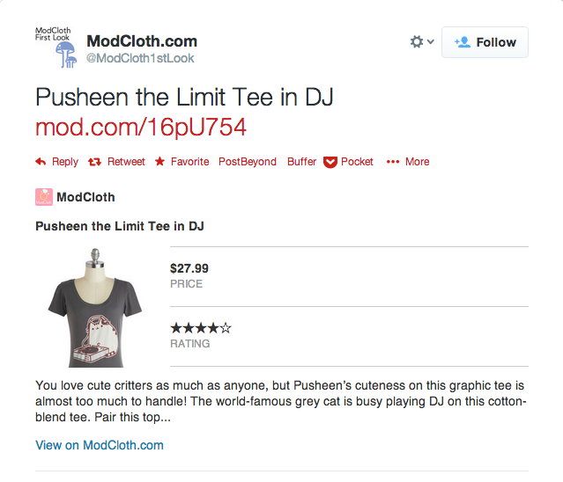
<meta name="twitter:card" content="product">
<meta name="twitter:title" content="Pusheen the Limit Tee">
<meta name="twitter:label1" content="PRICE">
<meta name="twitter:data1" content="$7.99">
<meta name="twitter:image:src" content="http://productshots2.modcloth.net/productshots/0120/6748/1d9bbcd088d86b4db0d35e9027758b04.jpg?1350070486">
<meta name="twitter:domain" content="ModCloth.com">
Twitter Cards

Slide 27
schema.org
Common vocabs and markup that search engines can understand
Ease the friction of publishing Linked/ Structured Data to the web
Linked, open data as a platform to build cool stuff on the web, improve user experience through data
Over 1200 schema objects and counting

Slide 28
Richly Annotated HTML
<div itemscope itemtype="http://data-vocabulary.org/Person">
My name is <span itemprop="name">Jay Myers</span>,
but people call me <span itemprop="nickname">Professor Jaymond Myers</span>.
Here is my homepage:
<a href="http://jaymmyers.tumblr.com" itemprop="url">http://jaymmyers.tumblr.com</a>.
I live in
<span itemprop="address" itemscope
itemtype="http://data-vocabulary.org/Address">
<span itemprop="locality">Minneapolis</span>,
<span itemprop="region">MN</span>
</span>
and work as a <span itemprop="title">Technical Product Manager</span>
at <span itemprop="affiliation">Best Buy, Co., Inc</span>.
</div>

Slide 29
Richly Annotated HTML
<div itemscope itemtype="http://data-vocabulary.org/Product">
<span itemprop="brand">ACME</span> <span itemprop="name">Executive
Stapler</span>
<img itemprop="image" src="http://upload.wikimedia.org/wikipedia/commons/thumb/2/2d/Swingline-stapler.jpg/220px-Swingline-stapler.jpg" />
<span itemprop="description">Sleeker than ACME's Classic Stapler, the
Executive Stapler is perfect for the business traveler
looking for a compact stapler to staple their papers.
</span>
Category: <span itemprop="category" content="Office Supplies > Tools > Staplers">Staplers</span>
Product #: <span itemprop="identifier" content="mpn:925872">
925872</span>
<span itemprop="review" itemscope itemtype="http://data-vocabulary.org/Review-aggregate">
<span itemprop="rating">4.4</span> stars, based on <span itemprop="count">89
</span> reviews
</span>
<span itemprop="offerDetails" itemscope itemtype="http://data-vocabulary.org/Offer">
Regular price: $179.99
<meta itemprop="currency" content="USD" />
$<span itemprop="price">119.99</span>
(Sale ends <time itemprop="priceValidUntil" datetime="2010-11-05">
5 November!</time>)
Available from: <span itemprop="seller">Executive Objects</span>
Condition: <span itemprop="condition" content="used">Previously owned,
in excellent condition</span>
<span itemprop="availability" content="in_stock">In stock! Order now!</span>
</span>
</div>

Slide 30
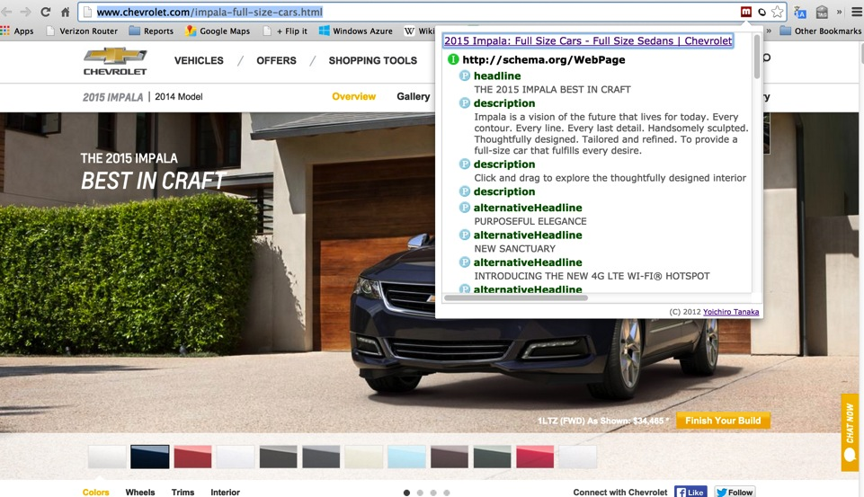

Slide 31
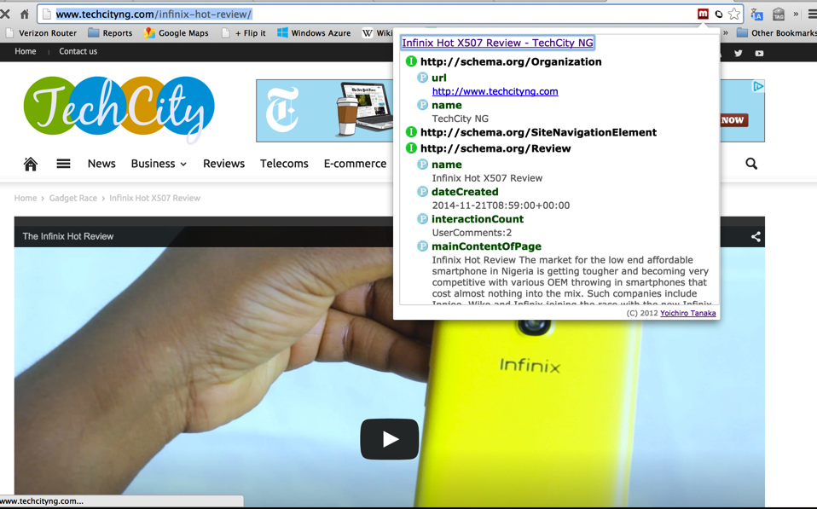

Slide 32
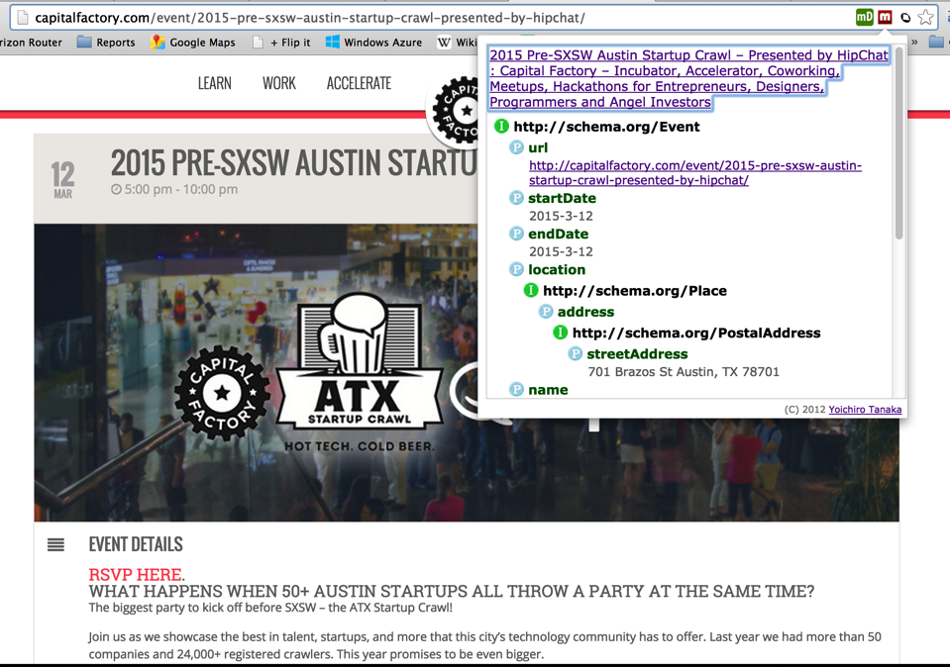

Slide 33
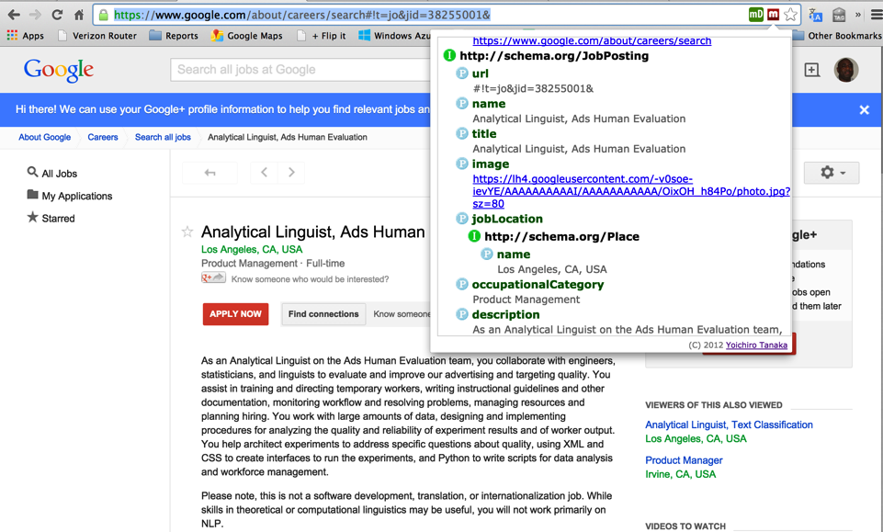

Slide 34
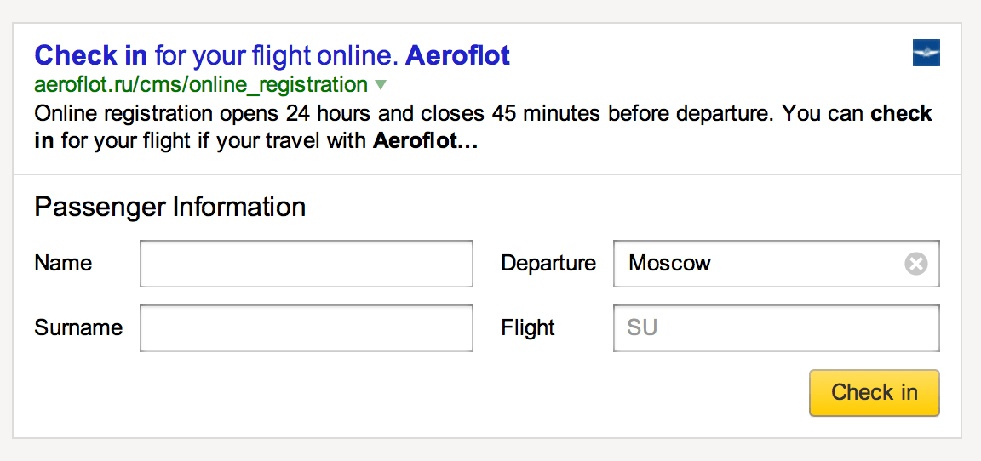
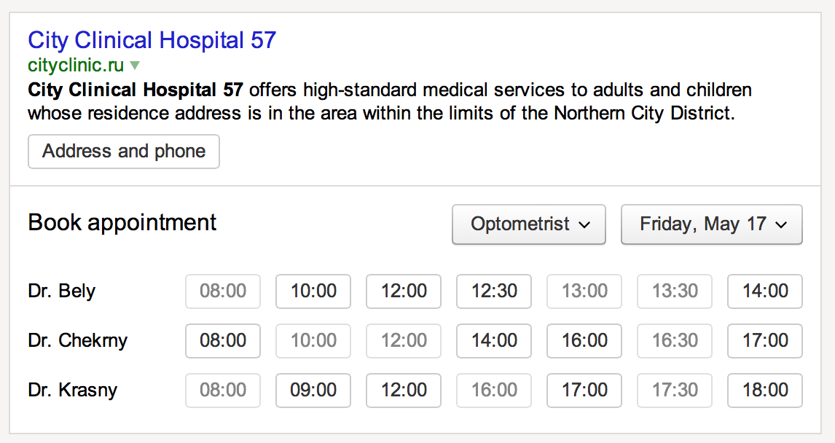
Yandex Islands

Slide 35
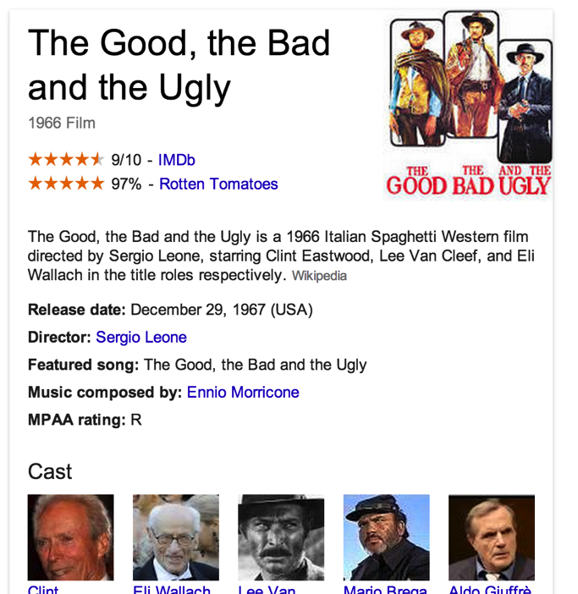
Google Knowledge Graph
Collection of data sources from schema.org markup

Slide 36
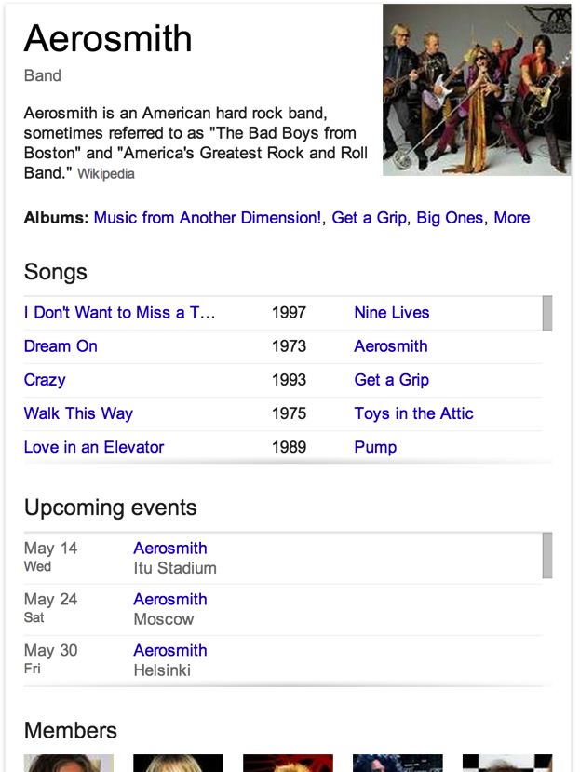
Google Knowledge Graph
Collection of data sources from schema.org markup

Slide 37
<script type="application/ld+json">
{
"@context": "http://schema.org",
"@type": "Order",
"merchant": {
"@type": "Organization",
"name": "bestbuy.com"
},
"orderNumber": "1234567890",
"priceCurrency": "USD",
"price": "29.99",
"acceptedOffer": {
"@type": "Offer",
"itemOffered": {
"@type": "Product",
"name": "Vinotemp - Epicureanist 3-in-1 Wine Bottle Stopper"
},
"price": “19.99",
"priceCurrency": "USD",
"eligibleQuantity": {
"@type": "QuantitativeValue",
"value": "1"
}
},
"url": "https://www.bestbuy.com/orderconf/?orderID=1234567890"
}
</script>

Slide 38
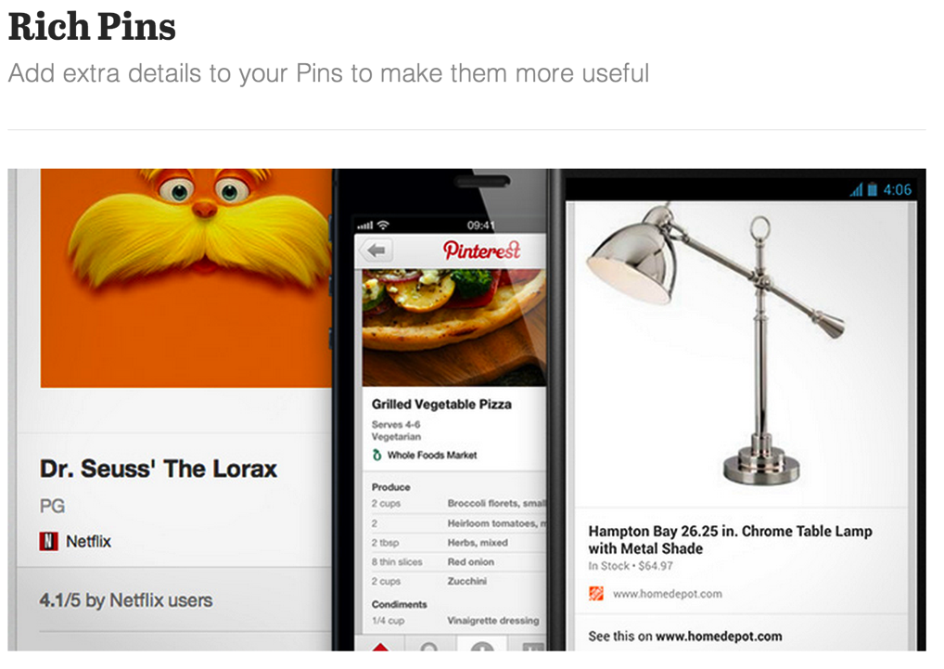
Pinterest Rich Pins

Slide 39
DBPedia < > Best Buy Mashups
Query: “Find me a description of the band Abba from the web of open
data and an album for sale by them at Best Buy”
Result: ABBA was a Swedish pop/rock group formed in
Stockholm in 1972, comprising Agnetha Fältskog, Benny
Andersson, Björn Ulvaeus and Anni-Frid Lyngstad.
AND
Best Buy Sells the CD: ABBAMania: Tribute to ABBA – Various
Artists, SKU 12073151

Slide 40
DBPedia < > Best Buy Mashups
Query: “Find me music artists from Ireland and album for sale by them at Best Buy”
Business result: 6% higher purchase conversion compared to commerce site

Slide 41
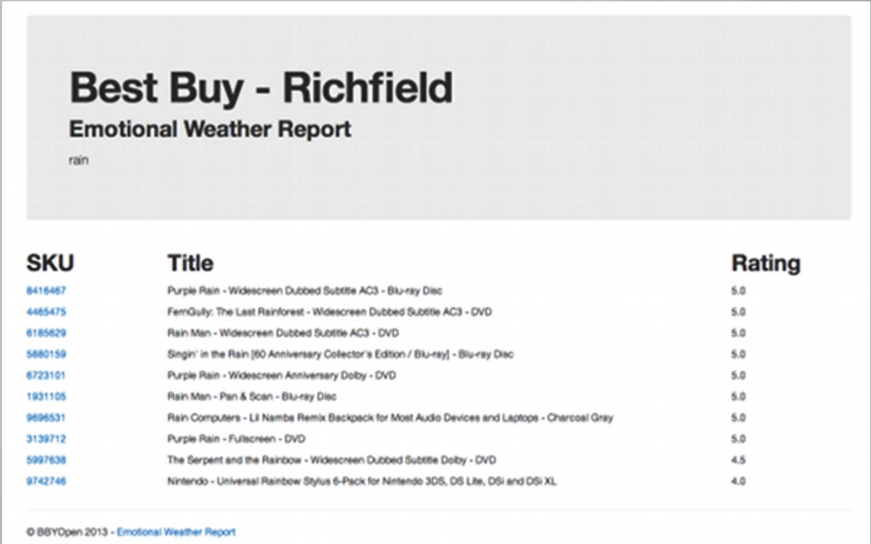
Emotional Weather Report POC
SPARQL query of a collection of data sources, display Best Buy products that match the mood people are in due to weather/ environment

Slide 42
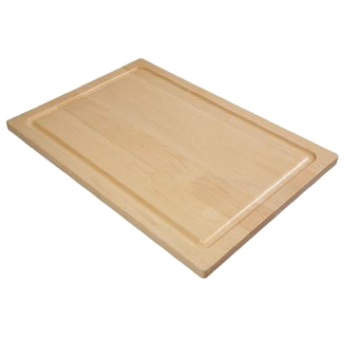
Data Relationships = Discovery of New Things

Slide 43
Linked Data Biz Benefits
New avenues of customer personalization
Deeper, more relevant and contextual customer experiences
Utilize all of your product catalog – the product “long tail”

Slide 44
Thank you!
@jaymyers
Notes:
Thanks!

Slide 45
Resources
Notes:
Thanks!

